Slide 1
Define decision tree
Decision tree is a supervised learning technique that can be used for both classification and regression problems, but mostly it is preferred for solving classification problems. It is a tree-structured classifier
Internal nodes represent the features of a dataset
Branches represent the decision rules
Each leaf node represents the outcome
In a Decision tree, there are two nodes, which are the
Decision nodes and
Leaf nodes
Decision nodes are used to make any decision and have multiple branches,
Leaf nodes are the output of those decisions and do not contain any further branches.
The decisions or the test are performed on the basis of features of the given dataset.

Slide 2
It is a graphical representation for getting all the possible solutions to a problem/decision based on given conditions. It is called a decision tree because, similar to a tree, it starts with the root node, which expands on further branches and constructs a tree-like structure. In order to build a tree, we use the CART algorithm, which stands for Classification and Regression Tree algorithm. A decision tree simply asks a question, and based on the answer (Yes/No), it further split the tree into subtrees. Below diagram explains the general structure of a decision tree:

Slide 3


Slide 4
What is decision node,root node, leaf node
Root Node: Root node is from where the decision tree starts. It represents the entire dataset, which further gets divided into two or more homogeneous sets.
Leaf Node: Leaf nodes are the final output node, and the tree cannot be segregated further after getting a leaf node.
Decision node:decision to be made

Slide 5
Define Entropy
As discussed above entropy helps us to build an appropriate decision tree for selecting the best splitter. Entropy can be defined as a measure of the purity of the sub split. Entropy always lies between 0 to 1. The entropy of any split can be calculated by this formula.
The algorithm calculates the entropy of each feature after every split and as the splitting continues on, it selects the best feature and starts splitting according to it. For a detailed calculation of entropy

Slide 6
Gini Index:
Gini index is a measure of impurity or purity used while creating a decision tree in the CART(Classification and Regression Tree) algorithm.
An attribute with the low Gini index should be preferred as compared to the high Gini index.
It only creates binary splits, and the CART algorithm uses the Gini index to create binary splits.
Gini index can be calculated using the below formula:
Gini Index= 1- ∑_{j}P_{j}²

Slide 7
Pruning: Getting an Optimal Decision tree
Pruning is a process of deleting the unnecessary nodes from a tree in order to get the optimal decision tree.
A too-large tree increases the risk of overfitting, and a small tree may not capture all the important features of the dataset. Therefore, a technique that decreases the size of the learning tree without reducing accuracy is known as Pruning. There are mainly two types of tree pruning technology used:
Cost Complexity Pruning
Reduced Error Pruning.

Slide 8
Processing of selecting root node
In a decision tree, for predicting the class of the given dataset, the algorithm starts from the root node of the tree. This algorithm compares the values of root attribute with the record (real dataset) attribute and, based on the comparison, follows the branch and jumps to the next node.
For the next node, the algorithm again compares the attribute value with the other sub-nodes and move further. It continues the process until it reaches the leaf node of the tree
Step-1: Begin the tree with the root node, says S, which contains the complete dataset.
Step-2: Find the best attribute in the dataset using Attribute Selection Measure (ASM).
Step-3: Divide the S into subsets that contains possible values for the best attributes.
Step-4: Generate the decision tree node, which contains the best attribute.
Step-5: Recursively make new decision trees using the subsets of the dataset created in step -3. Continue this process until a stage is reached where you cannot further classify the nodes and called the final node as a leaf node.

Slide 9
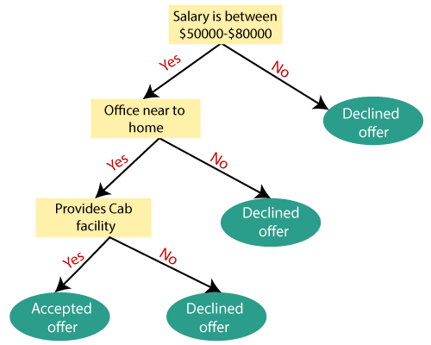
Example: Suppose there is a candidate who has a job offer and wants to decide whether he should accept the offer or Not. So, to solve this problem, the decision tree starts with the root node (Salary attribute by ASM). The root node splits further into the next decision node (distance from the office) and one leaf node based on the corresponding labels. The next decision node further gets split into one decision node (Cab facility) and one leaf node. Finally, the decision node splits into two leaf nodes (Accepted offers and Declined offer). Consider the below diagram:

Slide 10
Advantages of the Decision Tree
It is simple to understand as it follows the same process which a human follow while making any decision in real-life.
It can be very useful for solving decision-related problems.
It helps to think about all the possible outcomes for a problem.
There is less requirement of data cleaning compared to other algorithms.
Disadvantages of the Decision Tree
The decision tree contains lots of layers, which makes it complex.
It may have an overfitting issue, which can be resolved using the Random Forest algorithm.
For more class labels, the computational complexity of the decision tree may increase.

